Slide 1



Generative Models for the ultra-fast simulation of the LHCb experiment
Lucio Anderlini
Istituto Nazionale di Fisica Nucleare − Sezione di Firenze

Slide 2
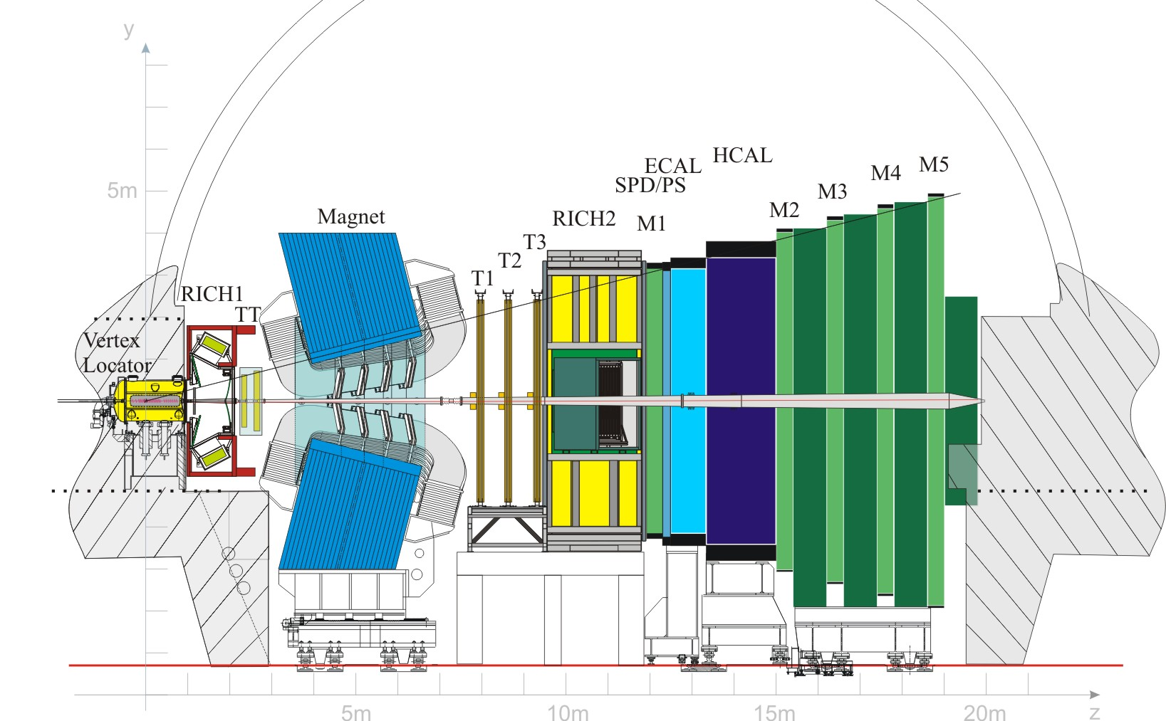
The LHCb experiment and its upgrades
Cherenkov detectors
Calorimeters
fully
software trigger system
The Upgrade I of the LHCb experiment is currently in commissioning. What’s new?
replacement of readout electronics
new full software trigger system
The new detector will be able to collect datasets at least one order of magnitude larger thanks to an increased instantaneous luminosity (x5) and a more performant selection algorithm (x2).
To match the increase of collected data, larger simulated samples and a strategy to speed-up their production is unavoidable.
x 5
instantaneous luminosity
x 2
selection efficiency
Vertex locator
Muon system
Tracking stations
x 10
data sample size
Detector paper
[JINST 3 (2008) S08005]
Upgrade design
[LHCb-TDR-12]

Slide 3
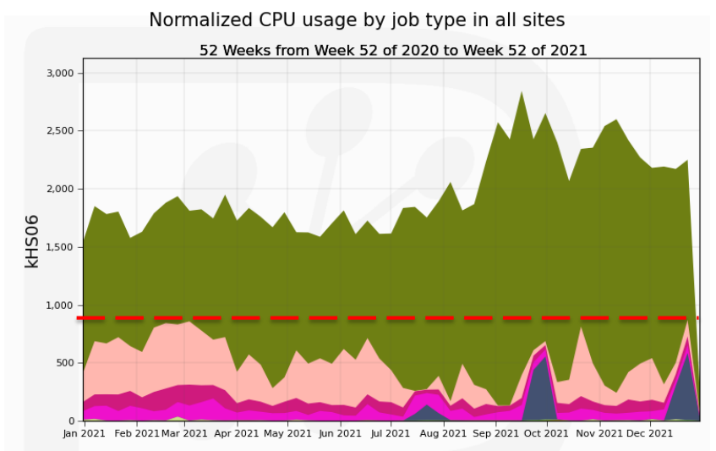
Simulating the LHCb experiment
LHCb-PUB-2022-011
Detailed Centralized MC productions. Interactions of particles with detector material is simulated with Geant4, and converted into hits. Same trigger & reconstruction algorithms are used as for real data.
Fast Simulation Replace parts of the simulation with models, e.g.
underlying event → ReDecay calorimeter deposits → CaloGAN
Detailed Sim.
Pledged
Fast Sim.
Analysis
Reprocessing
Detailed/Fast Simulation
Gauss*
Data processing
Generator
e.g. Pythia8
Simulation
Geant4
Event
Reconstruction
Decay Reconstruction
[Eur. Phys. J. C 78 (2018) 1009]
[arXiv:1812.01319]
* Gauss is the LHCb simulation framework based on Gaudi [J. Phys. Conf. Ser. 331 032023]

Slide 4
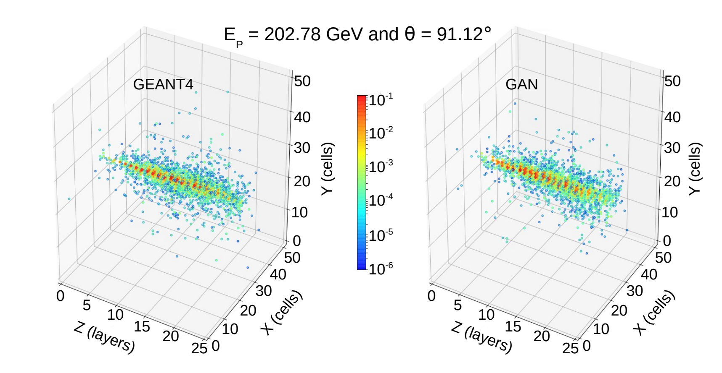
Machine Learning in Fast Simulation
Machine Learning models are studied to replace the Geant4 simulation phase as in most other experiments [Chekalina (2018), Khattak (2021)].
With these models the reconstruction step is the same as for real data (and detailed simulation).
Detailed/Fast Simulation
Gauss*
Data processing
Generator
e.g. Pythia8
Simulation
Geant4
Event
Reconstruction
Decay Reconstruction
* Gauss is the LHCb simulation framework based on Gaudi [J. Phys. Conf. Ser. 331 032023]

Slide 5
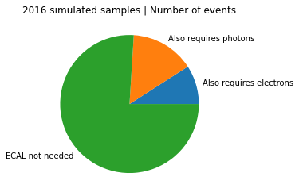
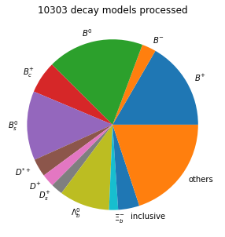
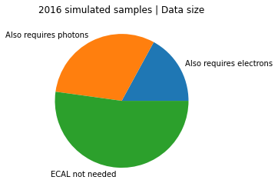
How does LHCb simulate events?
What should we parametrize first?
MC datasets generated with 2016 nominal conditions
Most simulated decay modes are heavy hadron decays.
The detector will provide very similar “response” to, e.g., a kaon from either a B⁺ or a B_{c}⁺.
We could save a lot of computing resources by parametrizing the detector response to that kaon and applying it to whatever decay model. Or, with Parametric Simulation.
10⁴
Head of the decay tree
Analyses involving h± and μ±, only, often drop simulated raw detector information immediately.

Slide 6
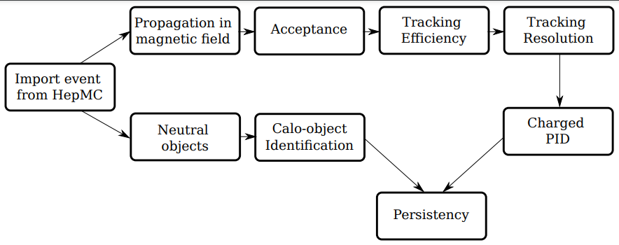
Lamarr: a pipeline of parameterizations embedded in Gauss
Lamarr is a pipeline of modular parametrizations, integrated with the LHCb analysis framework:
compatibility of the same, LHCb-tuned, generators
compatibility with the distributed computing middleware (LHCbDirac) and production environment
producing datasets with same persistency format
Not in this talk
Ultra-fast Simulation
Gauss
Generator
e.g. Pythia8
Simulation
Lamarr
Decay Reconstruction

Slide 7
The models

Slide 8
Machine Learning parametrizations: two families
Efficiencies
Gradient Boosted Decision Trees (GBDTs) trained on simulated data with Binary or Categorical Cross Entropy to predict the fraction of “good*” candidates, i.e. the “efficiency”of a specific step as a function of generator-level quantities.
GBDTs are robust and easy to train
Almost no preprocessing is needed
Reconstructed quantities
Conditional Generative Adversarial Networks trained on either simulated or calibration data.
Various GAN flavours adopted for different parameterizations balancing between accuracy and robustness.
Training is performed on opportunistic GPU resources provided to the Collaboration.
* either “accepted”, “reconstructed”, “selected”... depending on the context

Slide 9
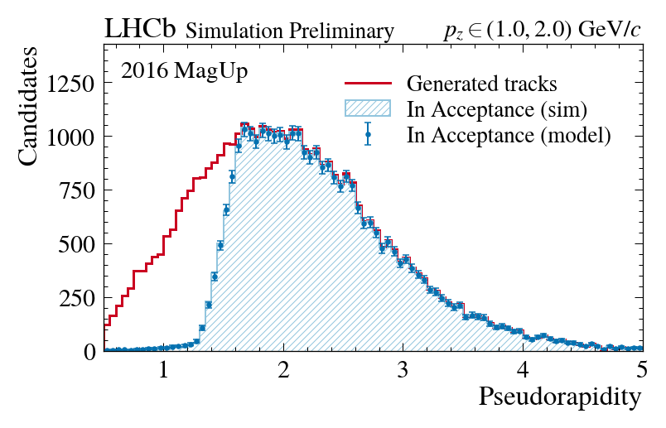

Geometrical acceptance
model : Gradient Boosted Decision Tree
loss : Binary Cross Entropy
input : position and slope of tracks
output : in acceptance [ True , False ]
[LHCb-FIGURE-2022-004]
Training performed on Detailed Simulation
The GBDT model well-reproduces the Detailed Simulation distribution of the generated tracks weighting by the probability of being in acceptance.
github.com/landerlini/lb-trksim-train
Tracking Models Training Repo

Slide 10
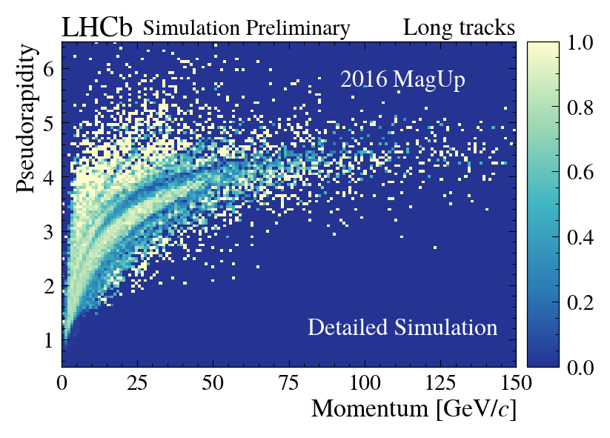
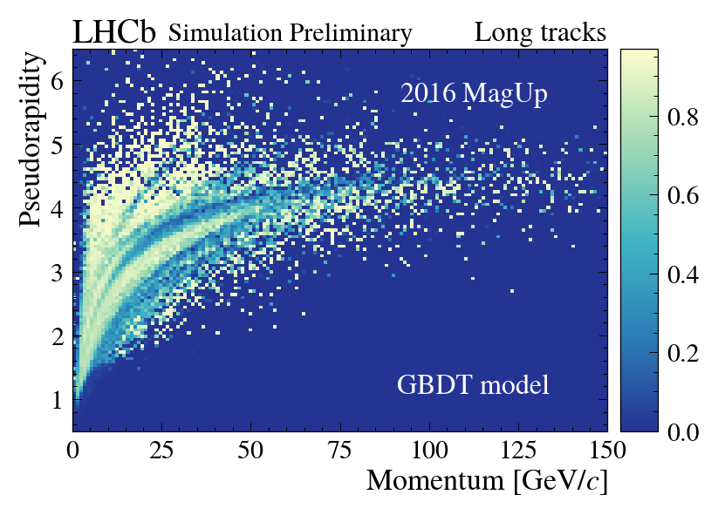
Tracking efficiency
model : Gradient Boosted Decision Tree
loss : Multi-class Cross Entropy
input : position and slope of tracks
output : track classification as [ long , upstream ,
downstream , non-reconstructed ]
[LHCb-FIGURE-2022-004]
Training performed on Detailed Simulation
The good performance of the GBDT model well-reproduces the complex structure of shadows describing the efficiency losses due to the non-trivial material sub-structure of the LHCb detector.
Weighted with
GBDT probability
(as “long track”)

Slide 11
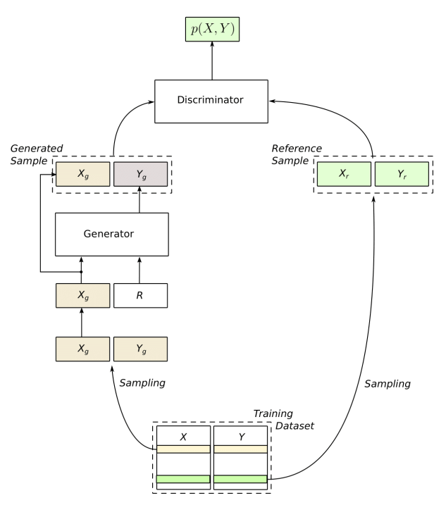
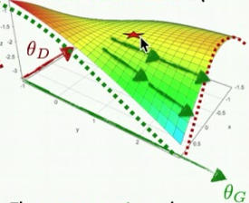
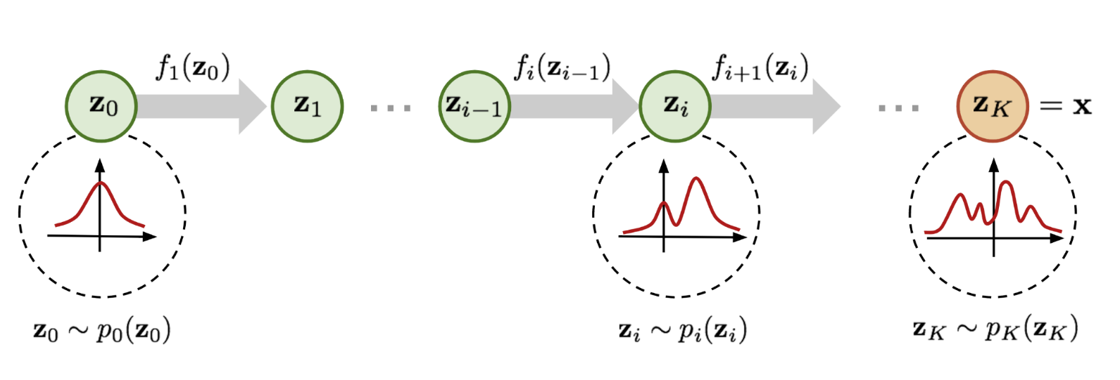
Generative Deep Neural Networks
Random numbers (with the right pdf)
DNN
Conditions
Generative Adversarial Networks (GANs) and Normalizing Flows (NFs) are emerging as go-to solutions for building parametrizations for fast simulations.
Not in this talk

Slide 12
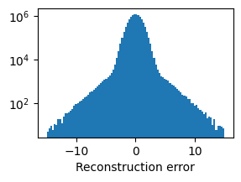
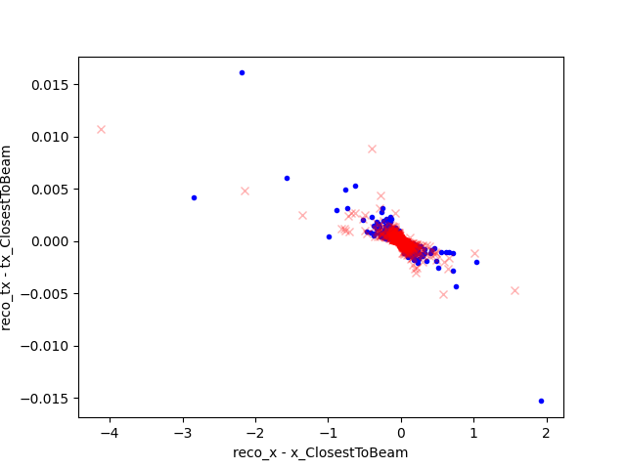
Tracking resolution modeling with a GAN
(cartoon)
Generator-level particle features
(origin position, momentum coords)
Reconstruction errors on intercept and slopes
DNN
(cartoon)
Smearing is most often treated by adding Gaussian-distributed noise.
Unfortunately, error distributions are not Gaussians and correlations between reconstruction errors are not trivial.
Error on slope t_{x}
Error on intercept x

Slide 13
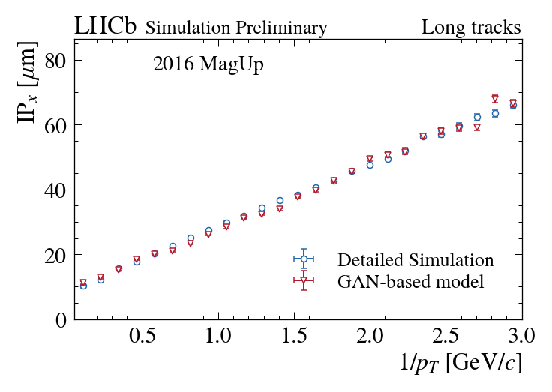
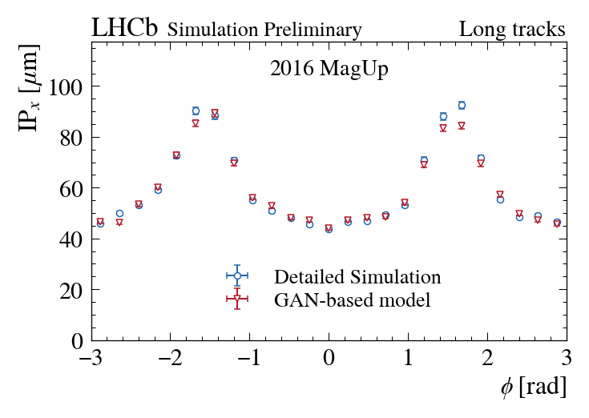
Tracking resolution
model : Generative Adversarial Networks
loss : Binary Cross Entropy
input : position, slope and momentum of tracks
output : reconstructed tracks information
[LHCb-FIGURE-2022-004]
Training performed on Detailed Simulation
The x-projection of the Impact Parameter of tracks originated from the Primary Vertex is well-reproduced by the GAN-based model even if neither the transverse momentum nor the phi angle are used for training.

Slide 14
Training Particle Identification on real data
To overcome the typical issues of GANs training, the parameterization of the LHCb Particle Identification system rely on CramerGAN: a stable, reliable and powerful GAN algorithm.
PID models are trained
using Calibration Samples
Need for removing
the residual background
The CramerGANs are used to define robust base models, parameterizing both the signal and background components within the Calibration Samples
The base models are then fine-tuned driven by either the Binary Cross Entropy or the Wasserstein distance as loss function
The fine-tuning strategies are modified to statistically subtract the background component [JINST 14 (2019) P08020]
github.com/mbarbetti/lb-pidsim-train
PID Models Training Repo
GAN issues
[arXiv:1701.04862]
CramerGAN
[arXiv:1705.10743]
Calibration samples
[LHCb-PUB-2016-020]

Slide 15
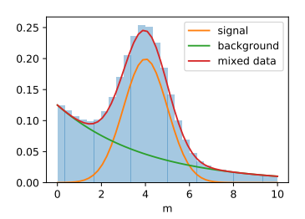
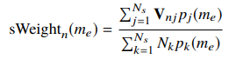
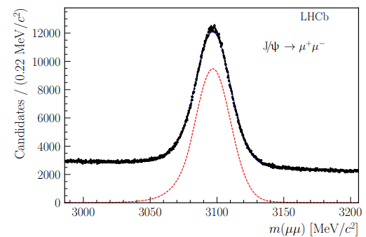
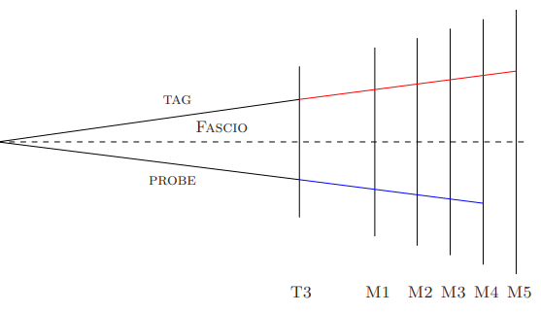
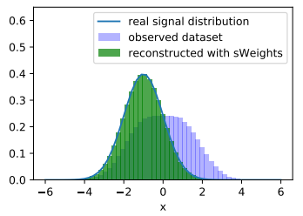
Training Particle Identification models on real data
Calibration datasets are obtained selecting special decay modes (enabling Particle Identification with tag&probe techniques) with special trigger lines explicitly avoiding biases on the probe.
Background is then subtracted with sPlot technique.
JINST 14 (2019) P08020

Slide 16
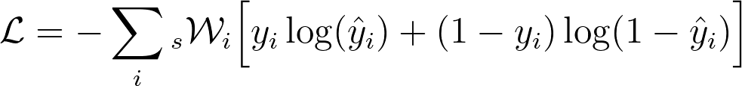
Modification to the loss to ignore the background
The loss function of the Discriminator is then simply modified to statistically subtract the background contribution.
For example for the binary cross-entropy,
Techniques to stabilize the GAN training when using negative weights were studied in more detail in [Borisyaka (2019)]

Slide 17
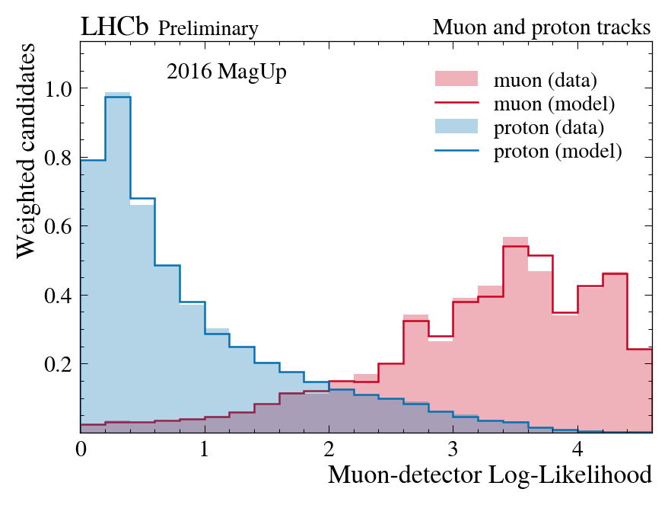
Muon detector: muon-proton separation
model : Generative Adversarial Networks
loss : Energy distance (baseline) +
BCE / Wasserstein distance (tuning)
input : track kinematic parameters and
detector occupancy
output : high-level response of the Muon detector
Training performed on Calibration Samples
2 neural networks trained in adversarial configuration are used to parameterize the high-level response of the Muon detector for muon and proton tracks.
[LHCb-FIGURE-2022-004]

Slide 18
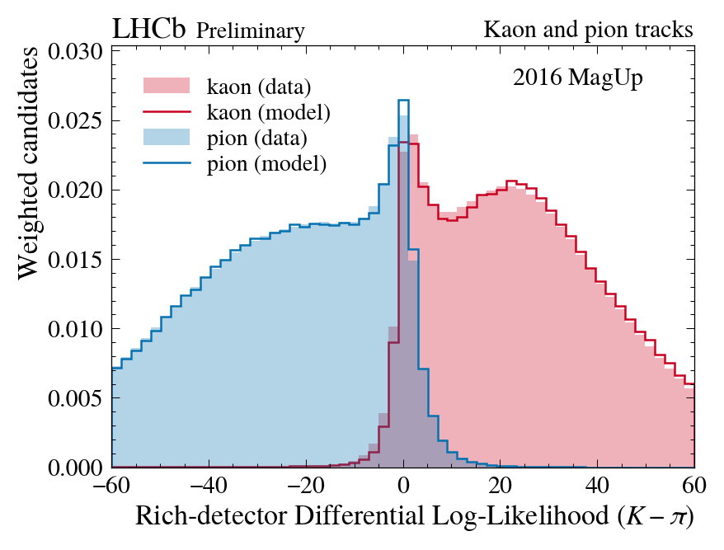
Rich detector: kaon-pion separation
model : Generative Adversarial Networks
loss : Energy distance (baseline) +
BCE / Wasserstein distance (tuning)
input : track kinematic parameters and
detector occupancy
output : high-level response of the Rich detector
Training performed on Calibration Samples
2 neural networks trained in adversarial configuration are used to parameterize the high-level response of the Rich detector for kaon and pion tracks.
[LHCb-FIGURE-2022-004]

Slide 19
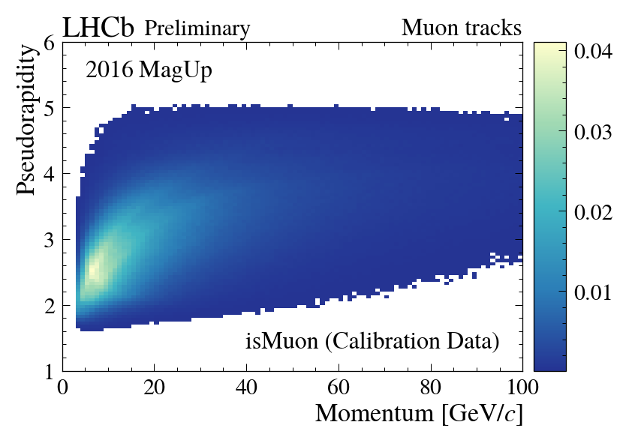
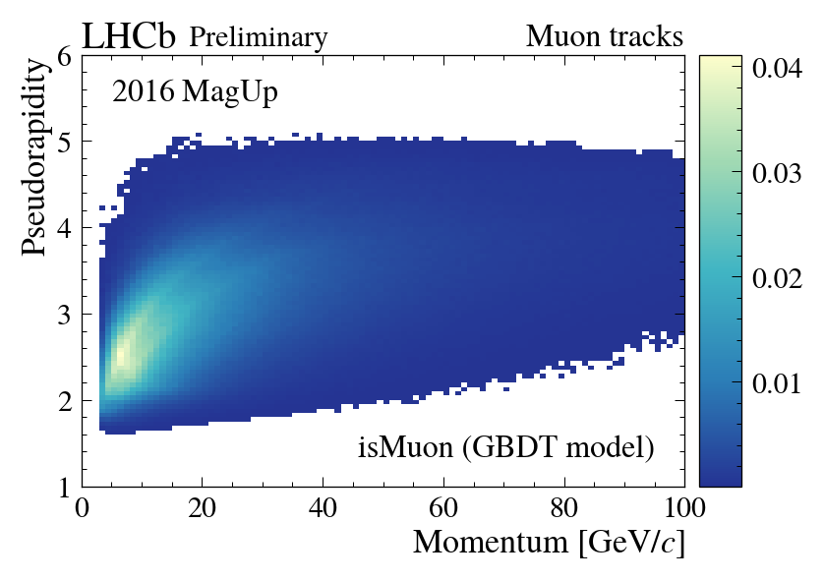
Loose Binary Muon Identification Criterion: isMuon
isMuon criterion
[JINST 8 (2013) P10020]
model : Gradient Boosted Decision Tree
loss : Binary Cross Entropy
input : track kinematic parameters and
detector occupancy
output : isMuon passed [ True , False ]
sWeighted
[LHCb-FIGURE-2022-004]
Training performed on Calibration Samples
The residual background of Calibration Samples is subtracted when training the GBDT. The model well-reproduces the behaviour of the isMuon criterion on data.
sWeighted +
weighted with
GBDT probability

Slide 20
PID system: stacking generative models
The kinematic parameters of the tracks and the detector occupancy information aren't enough to correctly parameterize the Global PID variables.
Training a new set of neural networks fed by the high-level response of the Rich and Muon detectors allows to parameterize the Global PID variables that can be retrieved in the inference phase through a stack of GANs.
The stack of GANs provides the higher-level response of the PID system.
Rich detector
GAN-based model
Kinematic parameters
generator + error models
Global PID variables
Detector occupancy
GAN-based model
look-up table
Muon detector
GAN-based model

Slide 21
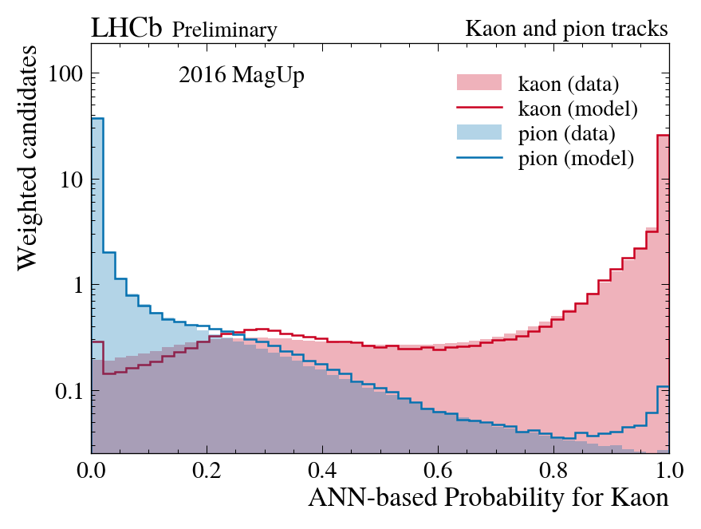
Global PID: kaon-pion separation
model : Generative Adversarial Networks
loss : Energy distance (baseline) +
BCE / Wasserstein distance (tuning)
input : track kinematic parameters ,
detector occupancy , isMuon ,
high-level response of the Rich detector ,
high-level response of the Muon detector
output : Global PID variables
Training performed on Calibration Samples
2 neural networks trained in adversarial configuration are used to parameterize a global PID variable named ProbNN for kaon and pion tracks.
[LHCb-FIGURE-2022-004]

Slide 22
Global PID: kaon-pion separation
model : Generative Adversarial Networks
loss : Energy distance (baseline) +
BCE / Wasserstein distance (tuning)
input : track kinematic parameters ,
detector occupancy , isMuon ,
high-level response of the Rich detector ,
high-level response of the Muon detector
output : Global PID variables
Imperfect background subtraction
Training performed on Calibration Samples
2 neural networks trained in adversarial configuration are used to parameterize a global PID variable named ProbNN for kaon and pion tracks.
[LHCb-FIGURE-2022-004]

Slide 23
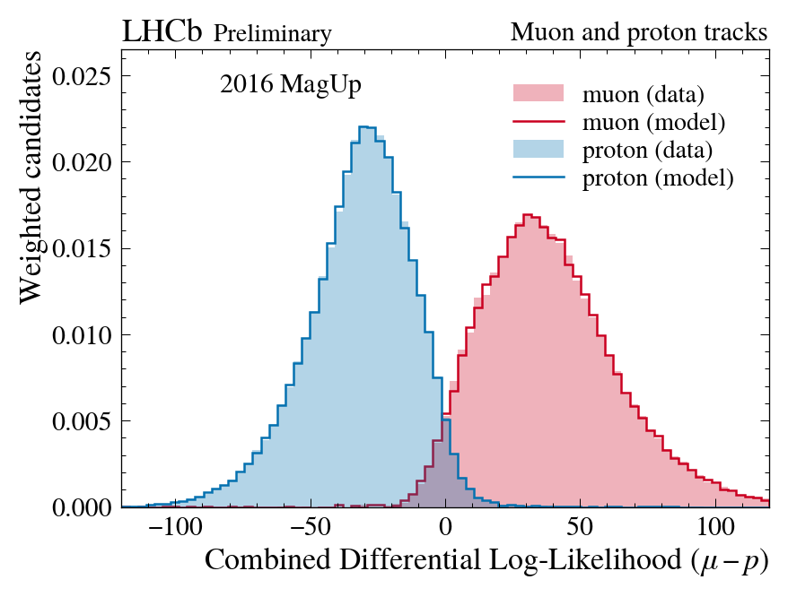
Global Particle Identification: muon-proton separation
model : Generative Adversarial Networks
loss : Energy distance (baseline) +
BCE / Wasserstein distance (tuning)
input : track kinematic parameters ,
detector occupancy , isMuon ,
high-level response of the Rich detector ,
high-level response of the Muon detector
output : Global PID variables
Training performed on Calibration Samples
4 neural networks trained in adversarial configuration are used to parameterize various global PID variables shown together in the Combined Differential Log-Likelihood for muon versus proton hypothesis.
[LHCb-FIGURE-2022-004]

Slide 24
Distributed HPO

Slide 25
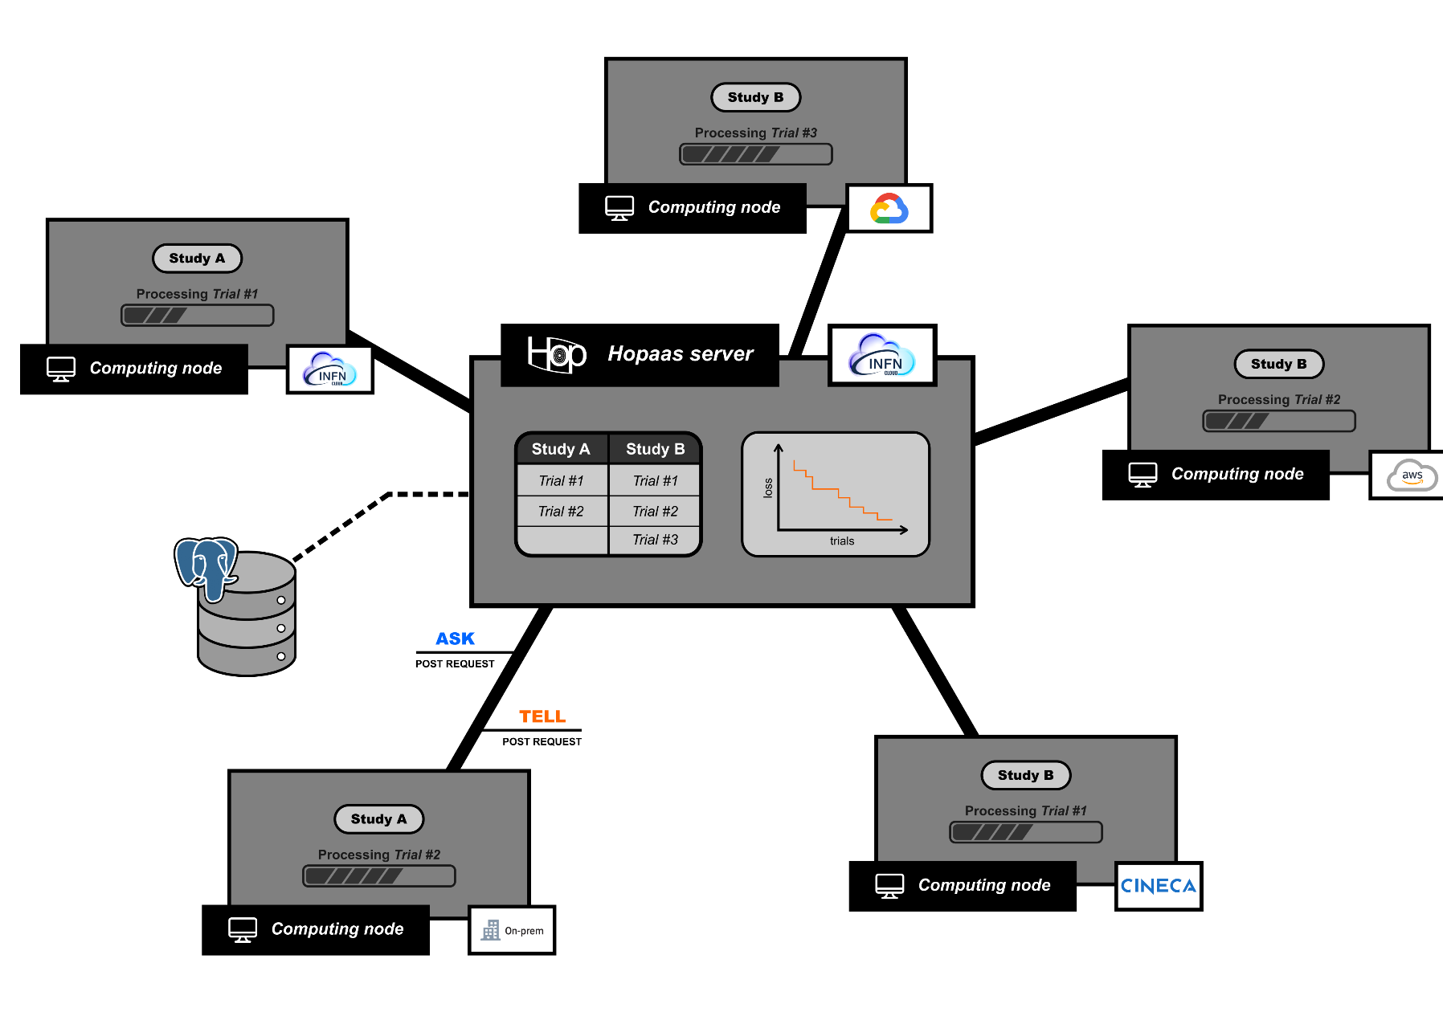
Distributed Hyper Parameter Optimization
Training GANs benefits from massive hyperparameter optimization campaigns.
To enable using opportunistic resources we need a centralized service for managing HPO campaigns, independent of the resource provider.
Web-based service hosted by INFN Cloud accessed through REST APIs

Slide 26
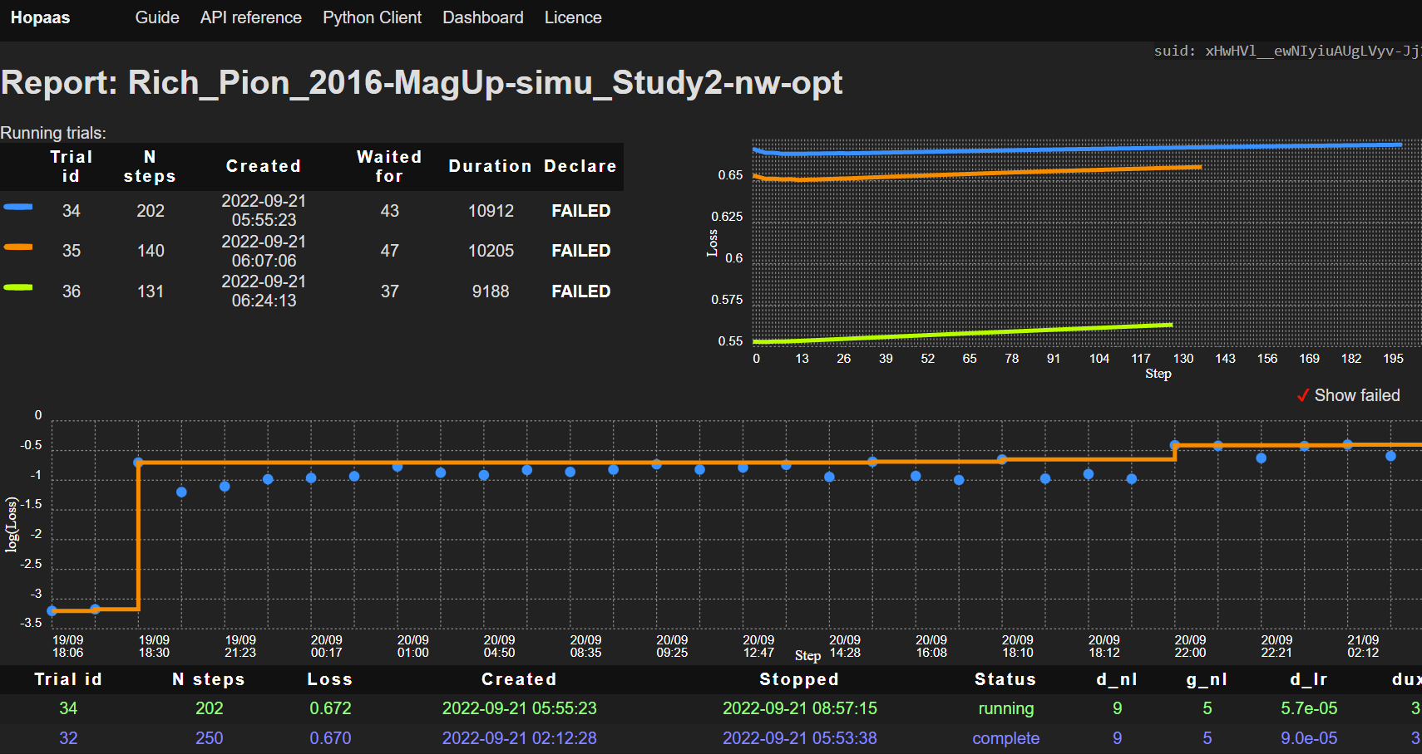
Referee network and dashboard
HPO
We use a referee network, architecturally equivalent to the discriminator, but evolving independently and never used to inform the generator, only for HPO.
REFEREE
Referee BCE

Slide 27
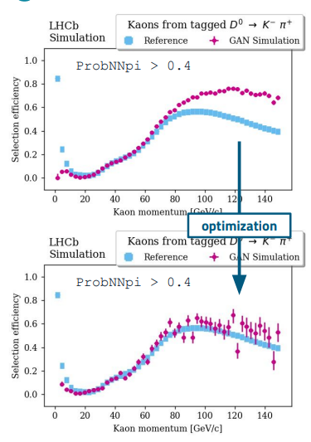
Effects of the HPO on PID efficiencies
HPO is observed to be particularly beneficial to improve modeling on the tails of the condition distributions.

Slide 28
Deployment in HEP C++ applications

Slide 29
Deploying trained models in Gauss
Using trained ML models in C++ applications is wider and more general issue.
Train in Python
Query in C/C++
Several options for deployment exist, but come with some practical limitation. For example,
Require external dependencies sometimes difficult to integrate in the build system of large HEP applications
Expect vectorized inputs introducing overhead for branched flows, as for example Geant4-based simulations
Introduce limits in the interplay between the preprocessing and algorithmic steps
Often require compiling with the framework large part of the algorithm.

Slide 30
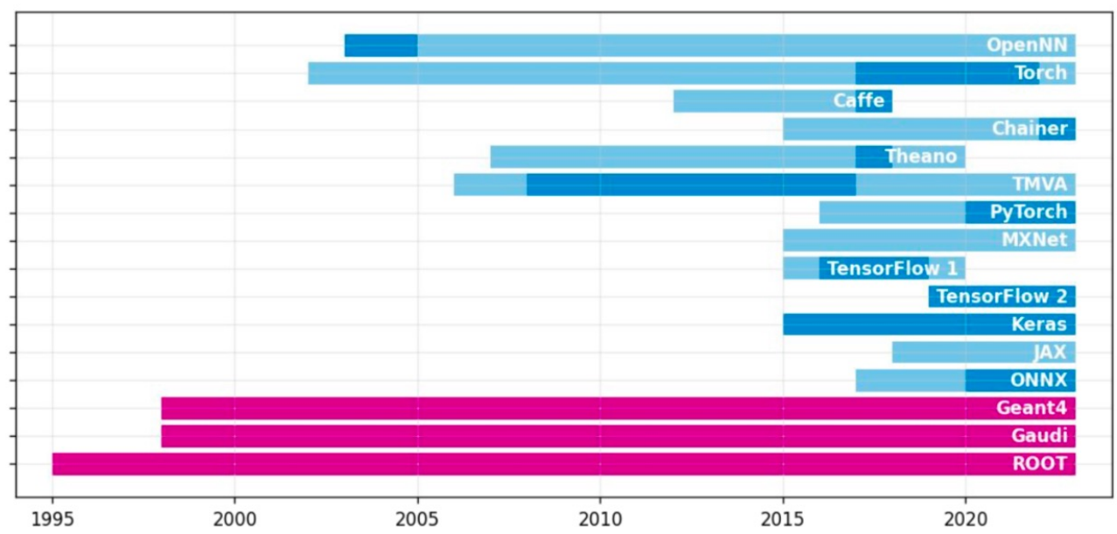
Choosing a DNN framework to rely on
Frameworks and standards to define and deploy DNN in C++ applications have change a lot during the last years.
Choosing one for an application we would like to keep using in production in O(10) years would be a bet.
Also, multithreading is used differently (and possibly inconsistently) by HEP frameworks and ML frameworks.

Slide 31
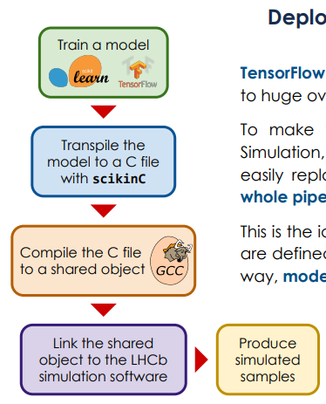
Transpiling approach: scikinC and keras2c
For a seamless integration of the trained parameterizations in the LHCb simulation framework models have to be applied to each single particle → thousands of independent calls per event.
Even a small latency (e.g. context switching) wastes unacceptable amount of CPU resources .
We transpile our models in C and compile them to binaries, dynamically linked at runtime.
LHCb tool: scikinC [PoS(CompTools2021)034] Possible partial migration to keras2c [J.Eng.App.AI, (2021) 104182]

Slide 32
Physics validation

Slide 33
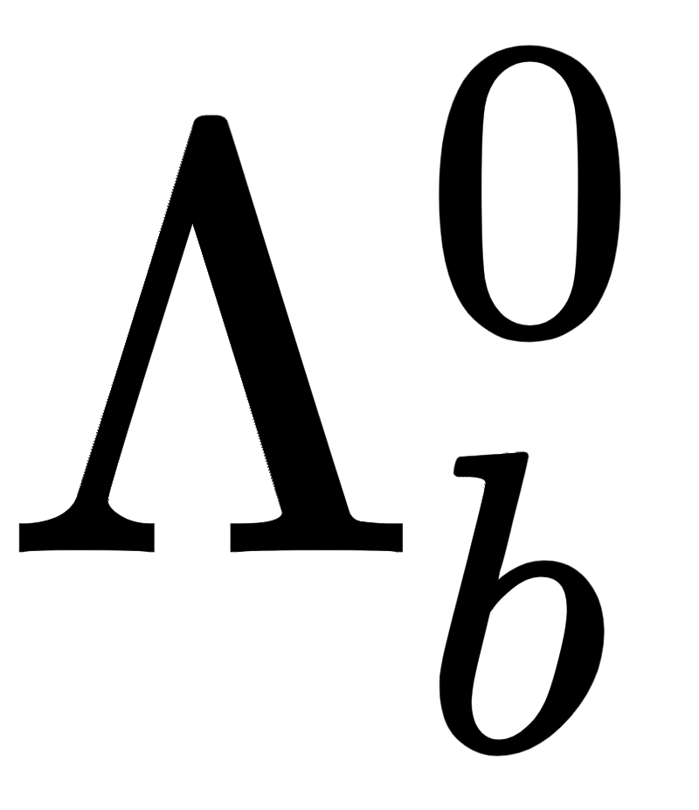
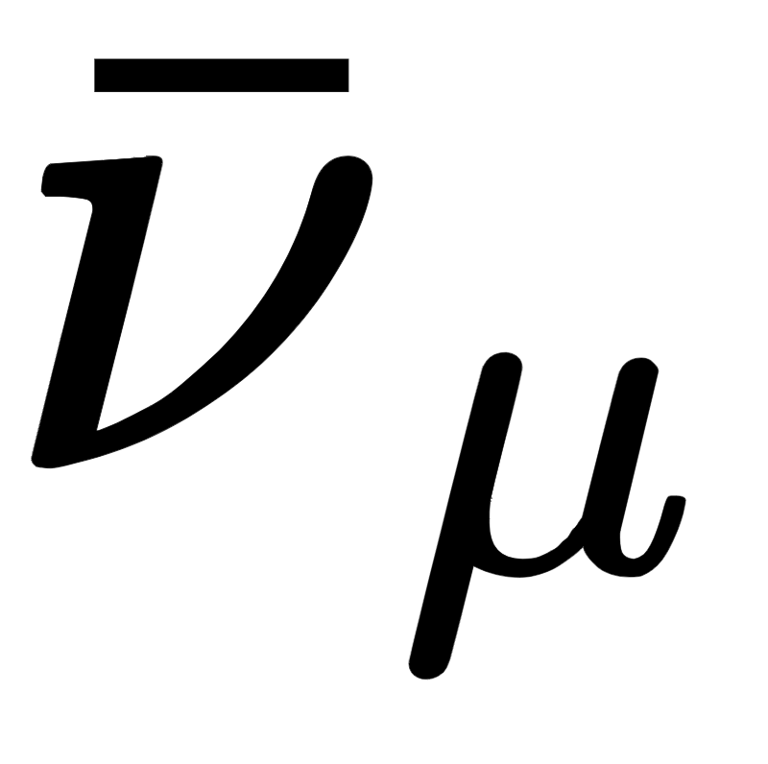
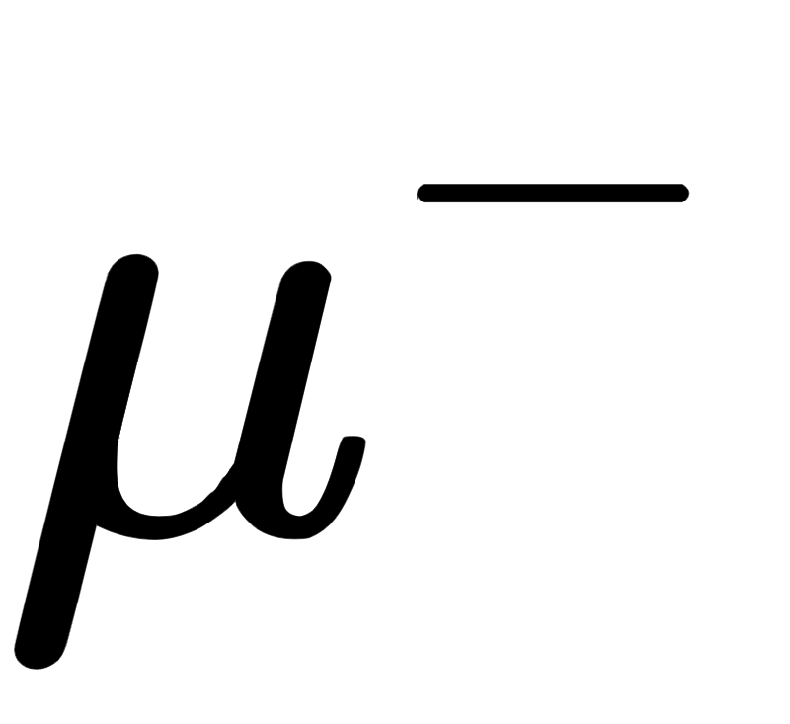
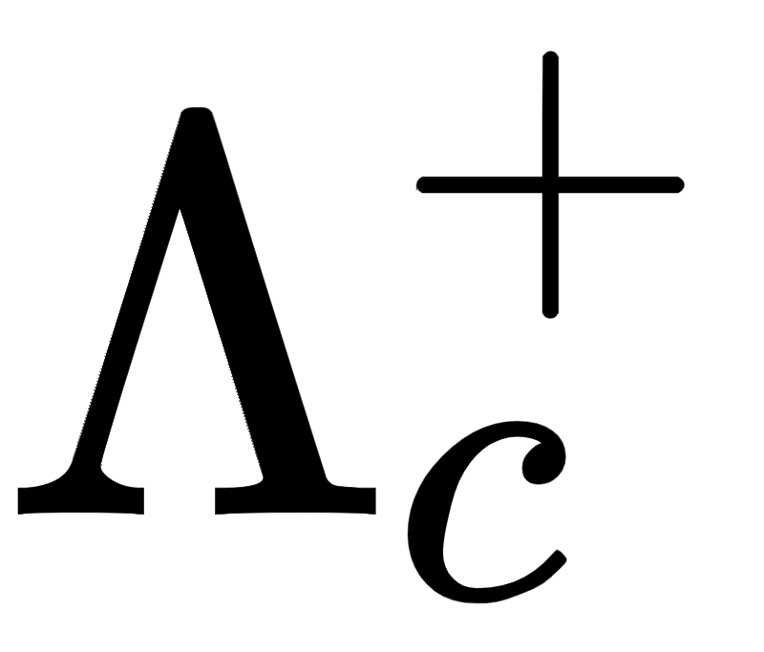
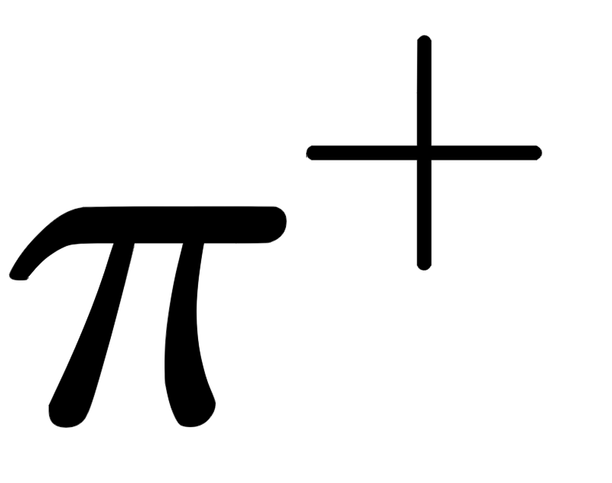
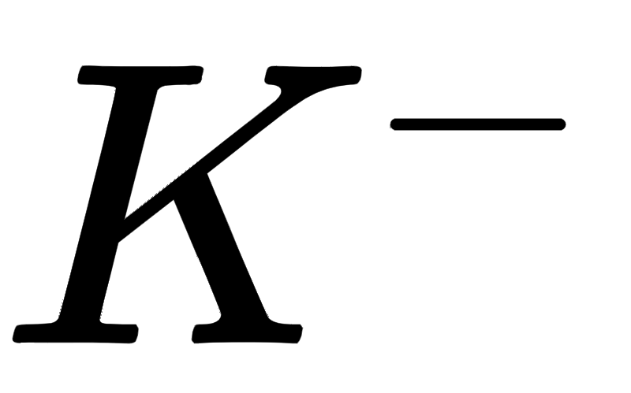

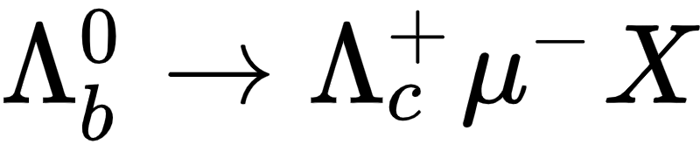
Lamarr validation:
Abundant decay in LHCb, widely studied to measure, e.g., beauty baryon production
e.g. see JHEP 10 (2021) 060, PHYS. REV. D100 (2019) 032001, PHYS. REV. D96 (2017) 112005, …
It is part of the Particle Identification Calibration samples [EPJ TI 2019 6:1];
It is described by a complex decay model including many feed-down modes;
It provides examples for muons, pions, kaons and protons in a single decay mode.
other particles?
other?
The training of the models is based on a cocktail of heavy flavour decays, where represents a negligible fraction.

Slide 34
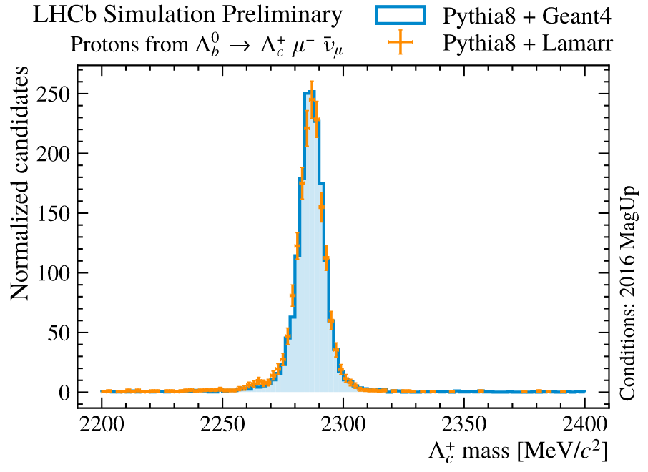
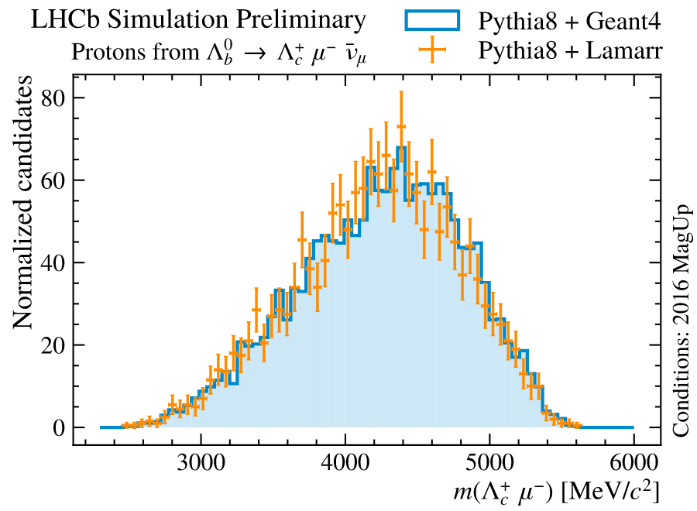
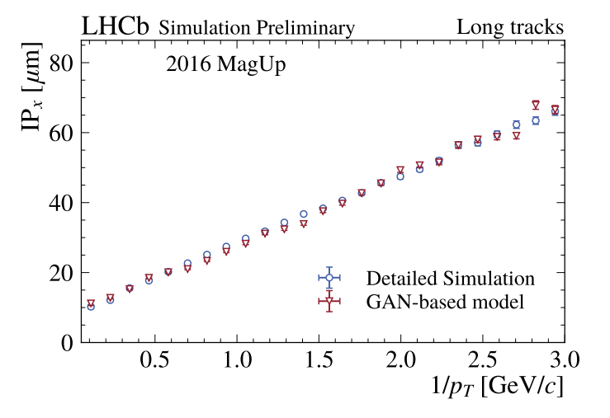
Track smearing
LHCb-FIGURE-2022-014
The momentum and point of closest approach to the beams of the generated particles get smeared: a GAN predicts effects as multiple scattering, imperfections of alignment, calibration…
Reconstructed masses and impact parameters are then computed on the smeared quantities.
LHCb-FIGURE-2022-014
LHCb-FIGURE-2022-004

Slide 35
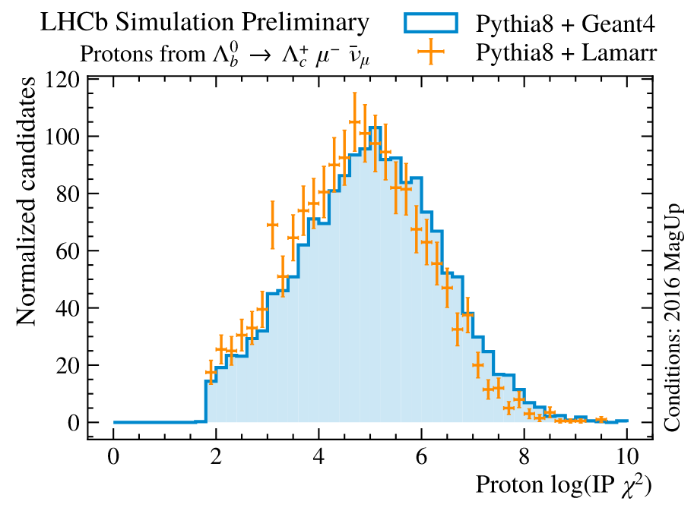
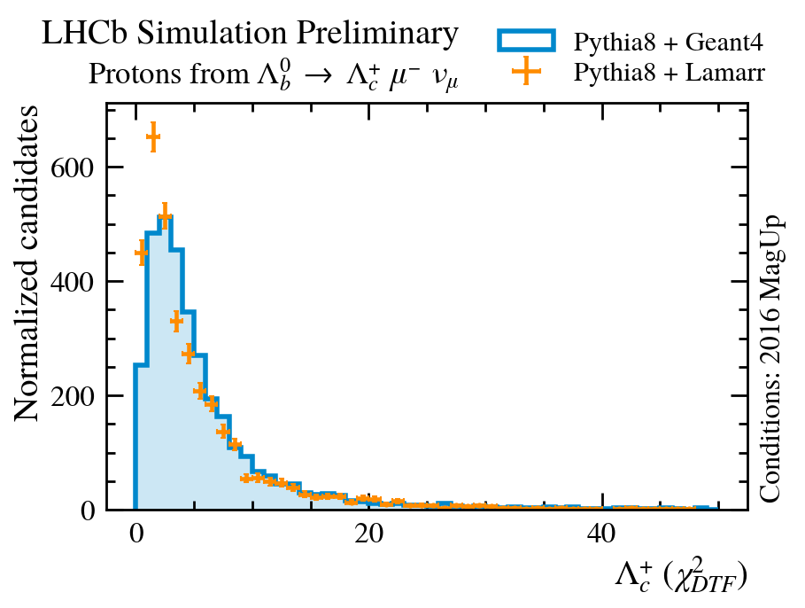
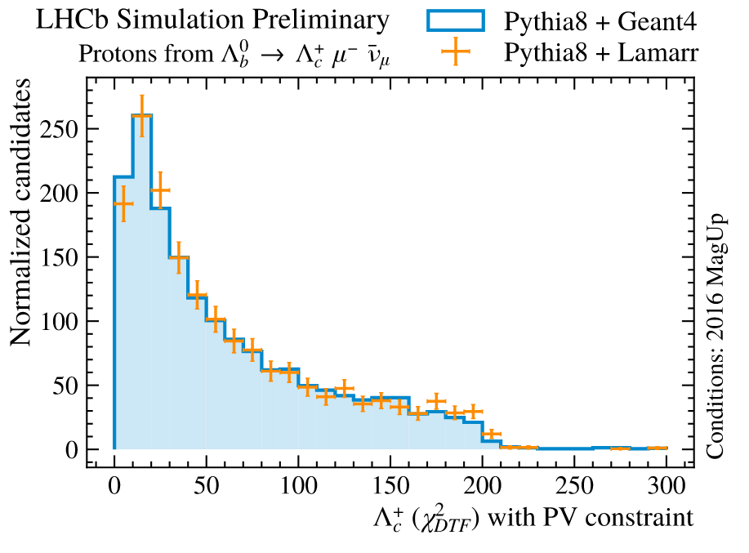
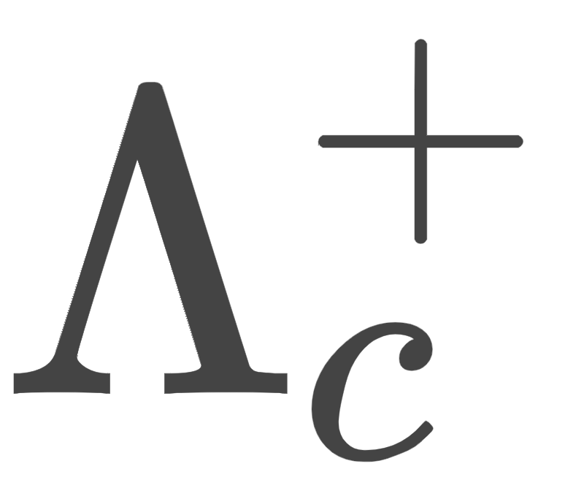
Tracking uncertainties
A GAN is used to predict the uncertainties associated to the track reconstruction.
Track uncertainties are crucial in LHCb to define the consistency of trajectories with vertices.
For example, the impact parameter 𝜒² is a measure of inconsistency of a trajectory with a PV.
LHCb-FIGURE-2022-014
The whole decay tree can be fitted at once with a Decay Tree Fitter
Constraining the to be produced in the PV, the 𝜒² explodes.
LHCb-FIGURE-2022-014
LHCb-FIGURE-2022-014
[NIMA 552 (2005) 566]
Include PV constraint

Slide 36
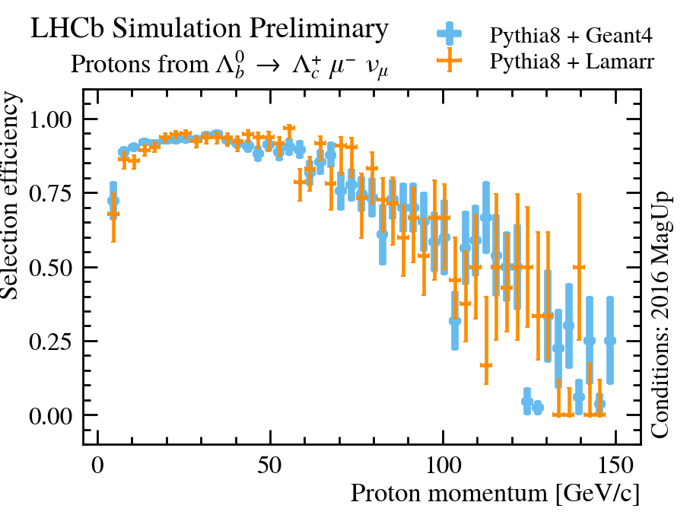
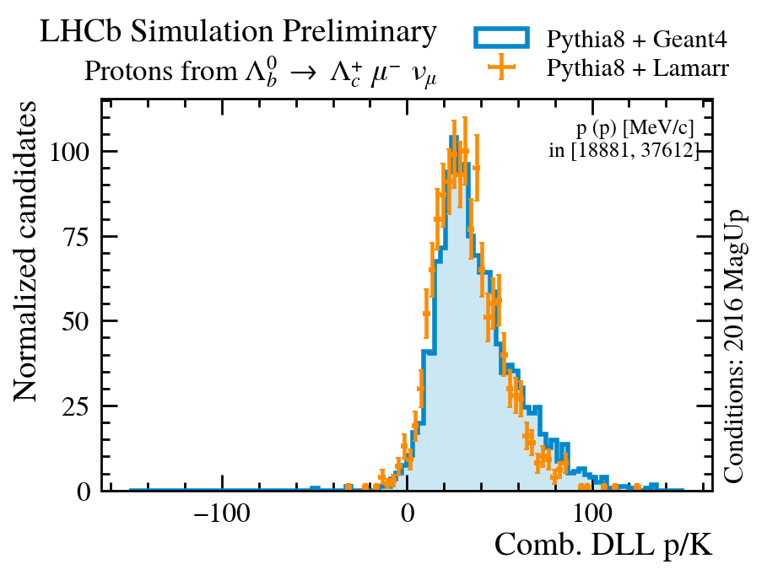

Proton identification
Lamarr simulates the distribution of the detector response. Analysts often inject the detector response in some analysis-specific classifier.
LHCb-FIGURE-2022-014
Proton identification
Proton misidentification as kaon
LHCb-FIGURE-2022-014
LHCb-FIGURE-2022-014
Here, we define cuts to visualize the ability of the trained models to describe the dependence of the detector response on occupancy and kinematics.

Slide 37

One more word on timing
Comparing the normalized CPU spent for Geant4-based and Lamarr simulations of decays we estimate a CPU reduction of 98.3 % for the Simulation phase.
Generation of b-baryons is exceptionally expensive: here Pythia 8 largely dominates the CPU consumption.
Generation of b-mesons requires 5% of less of the overall Simulation time.
Repeating the exercise on minimum bias, CPU reduction exceeds 99%.
Notes:
Donut charts: https://docs.google.com/spreadsheets/d/1iyAqO1tUaNjNBglh0DHNvq0jnJOSZ9ludDepEl46ZV0/edit?usp=sharing

Slide 38



Saving more with Particle Guns
LHCb-FIGURE-2022-014
Detector occupancy is parametrized: one can achieve similar performance by only simulating the signal particles (i.e. with Particle Guns).
Production spectra are generated once-for-all with Pythia8 and then sampled.
Detailed simulation: Pythia8 + Geant4
1M events @ 2.5 kHS06.s/event ≃ 80 HS06.y
LHCb-FIGURE-2022-014
Ultra-fast simulation: Pythia8 + Lamarr
1 M events @ 0.5 kHS06.s/event ≃ 15 HS06.y
LHCb-FIGURE-2022-014
Ultra-fast simulation: Particle Gun + Lamarr
100 M events @ 1 HS06.s/event ≃ 4 HS06.y

Slide 39
Conclusion and outlook

Slide 40

Technology Readiness Level & Limitations
With the start of Run 3, developing faster solutions to produce simulated samples is of key importance.
The Ultra-Fast Simulation at LHCb consists of modular components that can be used as single blocks within the Detailed Simulation or pipelined into a consistent purely-parametric complete simulation.
A stack of GANs can be used to effectively parameterize the higher-level response of the PID system.
Once trained, the models can be integrated within the LHCb simulation software as shared objects or easily replaced with new ones [details].
What’s next?
Models of the electromagnetic calorimeter (in progress)
shower libraries [EPJ Web Conf. 214 (2019) 02040] or Self-Attention GANs [EPJ Web Conf. 251 (2021) 03043] for the low-level response
a mixture of generative models and parametric functions for the high-level response
Models for all current and future LHCb datasets

Slide 41
Conclusion
Private productions are currently run on the WLCG and could be made standard, centralized productions easily.
We are now tuning models to compromise between accuracy and CPU performance, focusing on 2016 datataking conditions. We plan to extend to 2015, 2017 and 2018 soon. Run1 support may come later.
Lamarr will never replace Detailed Simulation, but may provide soon a precious tool to design selection strategies, train multivariate classifiers, study kinematic-induced correlation effects in the analysis-level quantities, or in general when theoretical uncertainties on the decay model are large.
As of today, these use-cases are mostly covered with Detailed Simulation.

Slide 42
Acknowledgements
This work is partially supported by ICSC – Centro Nazionale di Ricerca in High Performance Computing, Big Data and Quantum Computing, funded by European Union – NextGenerationEU.

